Slide 1
PHASE 1 – SYSTEMS PLANNING
System Analysis and Design Book

Slide 2
System Planning
Chapter 1
This chapter describes the role of information technology in today’s dynamic business environment. In this chapter, you will learn about the development of information systems, systems analysis and design concepts, and various systems development methods. This chapter also describes the role of the information technology department and its people.
Chapter 2
Chapter 3
In this chapter, you will learn about project management and how to plan, schedule, monitor, and report on IT projects.
This chapter also explains why it is important to understand business operations and requirements, how IT projects support a company’s overall strategic plan, how systems projects get started, and how systems analysts conduct a preliminary investigation and feasibility study

Slide 3
Introduction to systems Analysis and Design
Chapter 1

Slide 4
Information technology (IT)
refers to the combination of hardware, software, and services that people use to manage, communicate, and share information.
More than ever, business success depends on information technology.

Slide 5
Systems Development
Business information systems are developed by people who are technically qualified, business-oriented, and highly motivated. Successful developers also must be good communicators with strong analytical and critical thinking skills.

Slide 6
Systems Analysis and Design
is a step-by-step process for developing high-quality information systems.
An information system combines information technology, people, and data to support business requirements.
For example, information systems handle daily business transactions, improve company productivity, and help managers make sound decisions.

Slide 7
Who Develops Information Systems?
Traditionally, a company either developed its own information systems, called in-house applications, or purchased systems called software packages from outside vendors.
Regardless of the development method, launching a new information system involves risks as well as benefits.
What are some of the risks in you opinion?
The greatest risk occurs when a company tries to decide how the system will be constructed before determining what the system needs to do. Instead of putting the cart before the horse, a company must begin by outlining its business needs and identifying possible IT solutions.

Slide 8
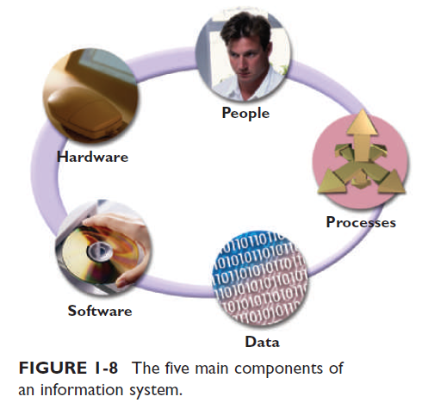
INFORMATION SYSTEM COMPONENTS
An information system has five key components, as shown in Figure 1-8: hardware, software, data, processes, and people.

Slide 9
Hardware
Hardware consists of everything in the physical layer of the information system. For example, hardware can include servers, workstations, networks, telecommunications equipment, fiber-optic cables, mobile devices, scanners, digital capture devices, and other technology-based infrastructure.

Slide 10
Software
Software refers to the programs that control the hardware and produce the desired information or results. Software consists of system software and application software.
System software manages the hardware components.

Slide 11
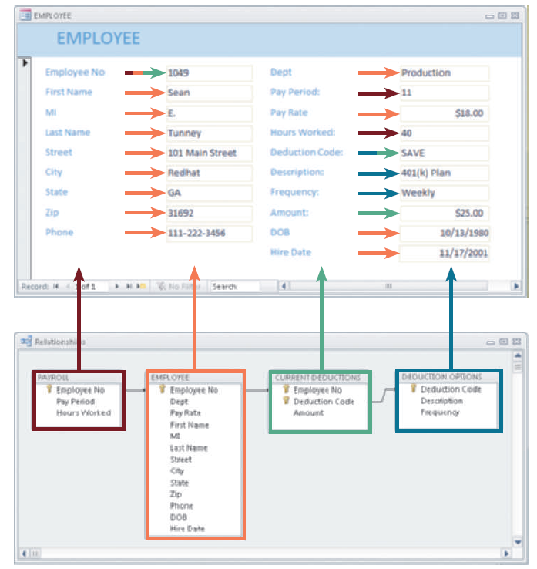
Data
Data is the raw material that an information system transforms into useful information. An information system can store data in various locations, called tables. By linking the tables, the system can extract specific information.

Slide 12
Processes
Processes describe the tasks and business functions that users, managers, and IT staff members perform to achieve specific results.
Processes are the building blocks of an information system because they represent actual day-to-day business operations.
To build a successful information system, analysts must understand business processes and document them carefully.

Slide 13
People
People who have an interest in an information system are called stakeholders.
Stakeholders include the management group responsible for the system, the users (sometimes called end users) inside and outside the company who will interact with the system, and IT staff members, such as systems analysts, programmers, and network administrators who develop and support the system.

Slide 14
UNDERSTAND THE BUSINESS
IT professionals must understand a company’s operations to design successful systems.
Each business situation is different.
Systems analysts use a process called business process modeling to represent company operations and information needs.

Slide 15
Business Profile
A business profile is an overview of a company’s
mission
functions
organization
products
services
customers
suppliers
competitors
constraints
future direction.

Slide 16
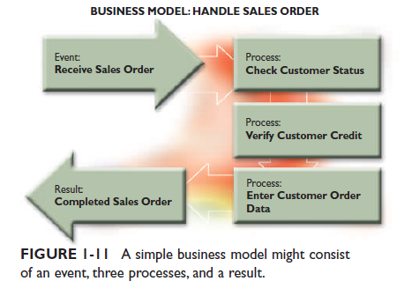
Business Process
A business process is a specific set of transactions, events, and results that can be described and documented.
A business process model (BPM) graphically displays one or more business processes

Slide 17
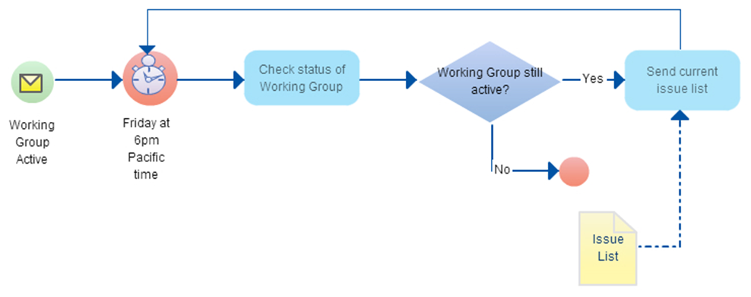
BPMN to represent events, processes and workflow

Slide 18
IMPACT OF THE INTERNET
Internet-based commerce is called e-commerce (electronic commerce) or I-commerce (Internet commerce).
E-commerce includes two main sectors: B2C (business-to-consumer) and B2B (business-to-business).
Google, Yahoo!, Amazon, and eBay are examples of pure dot-com companies.
At the other end of the scale are traditional firms, sometimes called brick-and-mortar companies because they conduct business primarily from physical locations.
Most successful brick-and-mortar firms — such as Lowe’s, Target, and Wal-Mart — have expanded their Web-based marketing channels to increase sales and serve customers better. This strategy combines the convenience of online shopping and the alternative of hands-on purchasing for customers who prefer that option.

Slide 19
B2C (Business-to-Consumer)
Using the Internet, consumers can go online to purchase an enormous variety of products and services.
This environment allows customers to do research, compare prices and features, check availability, arrange delivery, and choose payment methods in a single convenient session.
The business process model of retailer store is different from the business process model of online store.
Why do you think buying online is cheaper?

Slide 20
B2B (Business-to-Business)
Although the business-to-consumer (B2C) sector is more familiar to retail customers, the volume of business-to-business (B2B) transactions is many times greater.
Industry observers predict that B2B sales will increase sharply as more firms seek to improve efficiency and reduce costs.
What are some good examples of B2B web-sites?

Slide 21
BUSINESS INFORMATION SYSTEMS
In the past, IT managers divided systems into categories based on the user group (administrative, operational personnel, top managers etc..)
Today as you can see a lab worker making administrative tasks or use a software to make inventory orders, it make more since to identify the a system by its function and features.

Slide 22
Enterprise Computing
Enterprise computing refers to information systems that support company-wide operations and data management requirements rather than supporting individuals.
Now can you define the difference between enterprise software and consumer software?

Slide 23
Transaction Processing
Transaction processing (TP) systems process data generated by day-to-day business operations.
Examples of TP systems include customer order processing, accounts receivable, and warranty claim processing.

Slide 24
Business Support
Business support systems provide job-related information support to users at all levels of a company.

Slide 25
Knowledge Management
is the process of creating, sharing, using and managing the knowledge and information of an organization.
It refers to a multi-disciplinary approach to achieving organizational objectives by making the best use of knowledge.
A knowledge base consists of a large database that allows users to find information by entering keywords or questions in normal English phrases.

Slide 26
User Productivity
Companies provide employees at all levels with technology that improves productivity.
Examples of user productivity systems include e-mail, voice mail, fax, video and Web conferencing, word processing, automated calendars, database management, spreadsheets, desktop publishing, presentation graphics, company intranets, and high-speed Internet access.

Slide 27
Information Systems Integration
Most large companies require systems that combine transaction processing, business support, knowledge management, and user productivity features. For example, suppose an international customer has a problem with a product and makes a warranty claim.
A customer service representative enters the claim into a TP system. The transaction updates two other systems: a knowledge management system that tracks product problems and warranty activity, and a quality control system with decision support capabilities.

Slide 28
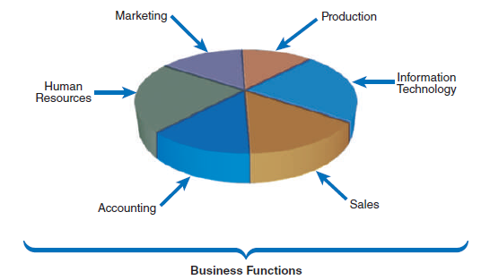
WHAT INFORMATION DO USERS NEED?
As part of downsizing and business process reengineering, many companies reduced the number of management levels and delegated responsibility to operational personnel.
Although modern organization charts tend to be flatter, an organizational hierarchy still exists in most companies.

Slide 29
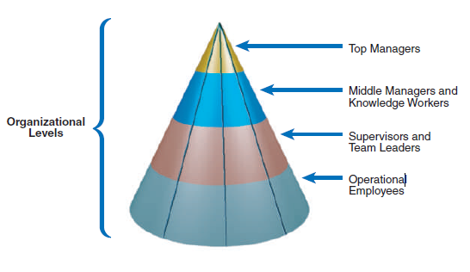
Top Managers
Top managers develop long-range plans, called strategic plans, which define the company’s overall mission and goals.

Slide 30
Middle Managers and Knowledge Workers
Middle managers provide direction, necessary resources, and performance feedback to supervisors and team leaders.
Middle managers need more detailed information than top managers, but somewhat less than supervisors who oversee day-to-day operations.

Slide 31
Supervisors and Team Leaders
Supervisors, often called team leaders, oversee operational employees and carry out day-to-day functions.

Slide 32
Operational Employees
Operational employees include users who rely on TP systems to enter and receive data they need to perform their jobs.

Slide 33


SYSTEMS DEVELOPMENT TOOLS
In addition to understanding business operations, systems analysts must know how to use a variety of techniques, such as modeling, prototyping, and computer-aided systems engineering tools to plan, design, and implement information systems.

Slide 34
Modeling
Modeling produces a graphical representation of a concept or process that systems developers can analyze, test, and modify.
A business model, or requirements model, describes the information that a system must provide.
A data model describes data structures and design.
An object model describes objects, which combine data and processes.
A network model describes the design and protocols of telecommunications links.
A process model describes the logic that programmers use to write code modules

Slide 35
Prototyping
Prototyping tests system concepts and provides an opportunity to examine input, output, and user interfaces before final decisions are made.
A prototype is an early working version of an information system.

Slide 36
Computer-Aided Systems Engineering (CASE) Tools
Computer-aided systems engineering (CASE), also called computer-aided software engineering, is a technique that uses powerful software, called CASE tools, to help systems analysts develop and maintain information systems.
CASE tools provide an overall framework for systems development and support a wide variety of design methodologies, including structured analysis and object-oriented analysis.

Slide 37
SYSTEMS DEVELOPMENT METHODS
Many options exist for developing information systems, but the most popular alternatives are structured analysis, which is a traditional method that still widely used, object-oriented (O-O) analysis, which is a more recent approach that many analysts prefer, and agile methods, also called adaptive methods, which include the latest trends in software development.

Slide 38
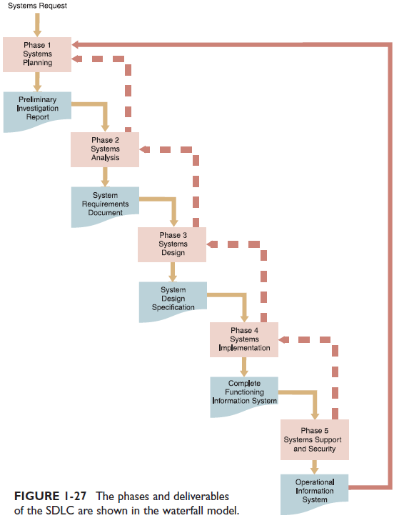
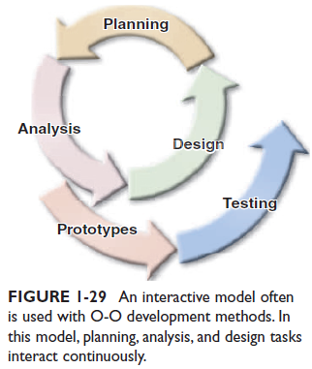
 | Structured Analysis | Object Oriented Analysis | Agile Methods
Description | Represents the system in terms of data and the process that act on that data figure 1-27 | View the system in terms of objects that combine data and processes. The objects represents actual people, things, transactions and events. figure 1-29 | Stresses intense team-based effort, breaks development process down into cycles.
Modeling tools | Data flow diagrams | Various object-oriented diagrams | Tools that enhance communications such as collaborative software, brainstorming and whiteboards
Pros | Became very popular over time, relies heavily on written documentation. | Integrates easily with OOP languages. | Very flexible and efficient in dealing with change.
Cons | Changes can be costly especially with later phases. | Interaction of objects and classes can be complex in larger systems | Team members need a high level of technical and communication skill.

Slide 39

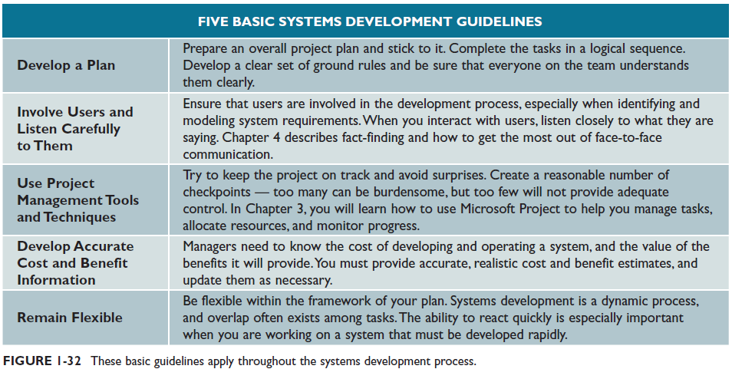
SYSTEMS DEVELOPMENT GUIDELINES these guidelines will help you achieve success as a systems analyst.

Slide 40
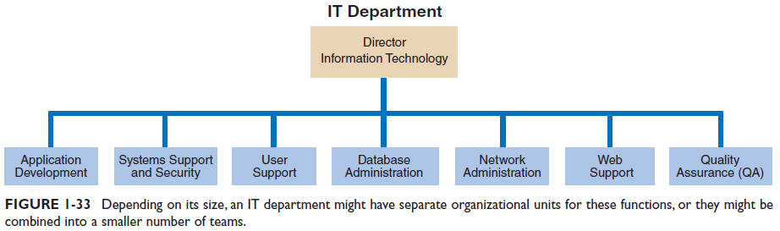
THE INFORMATION TECHNOLOGY DEPARTMENT
The IT department develops and maintains information systems.
In a small firm, one person might handle all computer support activities and services, whereas a large corporation might require many people with specialized skills to provide information systems support.

Slide 41

In class discussion
Computers perform many jobs that previously were performed by people. Will computer-based transactions and expanded e-commerce eventually replace person to-person contact? From a customer’s point of view, is this better? Why or why not?

Slide 42
Chapter 1 Assignment
What is information technology and why is it important? Suggest three fictitious headlines that might be added to Figure 1-1 on page 2.
Why would a systems analyst have to act as a translator? What groups might be involved?
Write a business profile for a large business in your town. You can use your imagination to supply details you might not know.
What strategies are Wal-Mart and Lowes using to gain more online customers?
Identify the main components of an information system. What is a mission-critical system?
Compare enterprise computing systems to transaction processing systems. Provide three examples of each type of system.
What are the four organizational levels common to many businesses? Which level typically requires data that supports long-term strategic planning and the overall business enterprise? What level of worker might rely heavily on transaction processing systems?
Describe three systems development tools and three development methods.
What are the phases of the SDLC waterfall model? Who was Barry Boehm, and what did he have to say about spiral models?
Review the IBM history on page 4, and then consider the powerful statement shown in Figure 1-33 on page 33. Is there a connection between the two? Why or why not?

Slide 43
Chapter 1 – Project
As part of your job search, you decide to find out more about salaries and qualifications for systems analysts in the area where you would like to work. To increase your knowledge, search the Internet to perform the following research:
Find information about a career as a systems analyst.
Use the Internet to determine whether the Federal Bureau of Labor Statistics lists salary information for systems analysts in the area where you would like to work. If so, summarize the information you find.
Find three online job postings for systems analysts. List the employers, the qualifications, and the salaries, if mentioned.
Visit monster.com and search for IT positions. Report your findings

